Slide 1
NFL Power Rankings
Cam Eon

Slide 2

Overview
Objectives
Problem Specifications
Solution Design
Tools List
Algorithm
Time Schedule
Grading Scheme
Deliverables
References
Questions

Slide 3
Student Objectives
Understand more on how the Elo algorithm works
Gather game data from 2020 season
Gather preseason Elo Ratings
Enhance my skills in Java, JavaScript, HTML, CSS and php MyAdmin
Enhanced my skills in R
By creating this program, it will give the user an idea of where their favorite team would be in the standing

Slide 4
Problem Specification
NFL Power Rankings is going to calculate the two team's strength in playing.
The home or away team winning makes the ratings update.
The way this is going to work is by getting the overall ratings from FiveThirtyEight.
The Elo ratings are going to be based on the 2020-2021 season.
Once running the program, it will give the updated list of the ratings
Input a team to see their ratings from all weeks played

Slide 5
Solution Design
Rating Increase
Move up in standings
Team 1
Win
Lose
Team 2
Rating Decrease
Move down in standings

Slide 6
Solution Design
There will be 32 NFL teams
In the Webapp it gives you all entries from week 0 to week 21
If the team wins their Elo rating increases and move up in the standings
If the team loses their Elo rating decreases and move down in the standings
By typing in the team name you can see their ratings for the whole season

Slide 7
Tools List
R
RStudio
Shiny WebApp
Github
WordPress

Slide 8
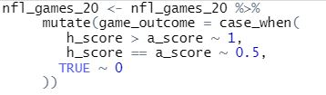
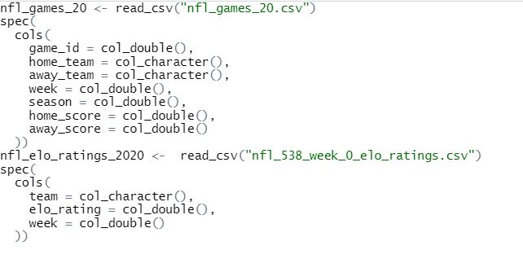
Algorithm
Here in the first step, we are saying if the home score is higher than the away score, they get a win and vice versa.
Here in the second step, it is reading the two excel files I converted into csv files, into two dataset tables

Slide 9
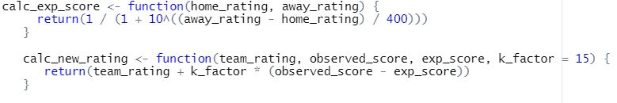
Algorithm
Here in step 3, we are using our equation to calculate the new rating and expected score.

Slide 10
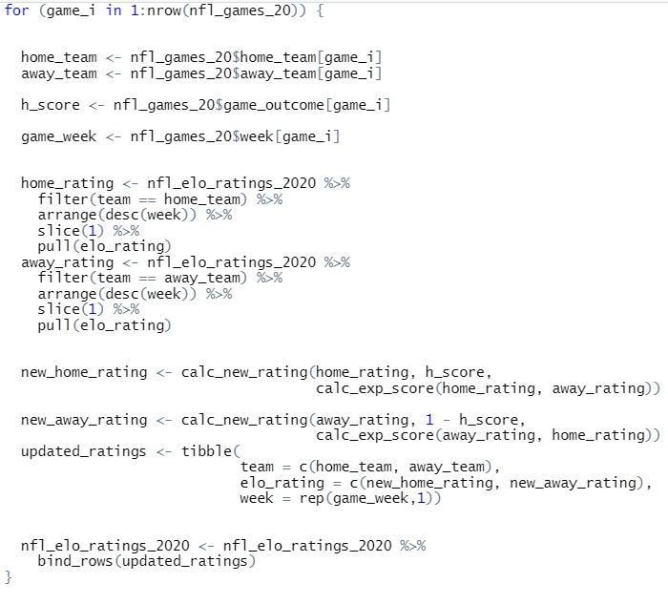
Algorithm
Here in step 4, this is the main part, here I am taking data from both data sets and combing them into one while updating all of the teams Elo ratings for each week

Slide 11
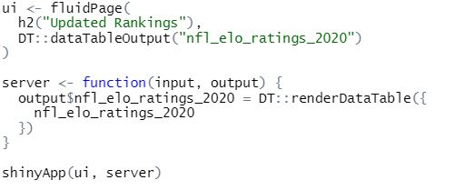
Algorithm
Here is the final step, here it is creating the shiny WebApp within R where it is compiling all of the data into a web app where you can see the results and filter them.

Slide 12
Time Schedule
1. Weeks 1: Collect data from NFL season of 2020-2021
2. Weeks 2-5: Program the algorithm with Data from previous weeks
3. Weeks 6-11: Make website for the algorithm to see the power ratings
4. Weeks 11-13: Test website to make sure everything works and fix bugs if needed
5. Week 14: Prepare presentation and report

Slide 13
Grading Scheme

Slide 14
Deliverables
• Proposal
• Source code for the algorithm
• Source code for the website
• All data collection
• Project journal
• Project report
• Final presentation

Slide 15
Sources and references

